Slide 1


Python + IOT
Course 7
Ver. 01
Copyright @ 2018 Innovaker

Slide 2


Course 6 Summary
. Basic concept of electric circuit
. What is PIR motion sensor?
. Demo project --- PIR motion sensor project 1
. Demo project --- PIR motion sensor project 2
2
Copyright @ 2018 Innovaker

Slide 3
quick review basic concept of Electricity
Electricity is the movement of electrons. Electrons create charge, which we can harness to do work. Your lightbulb, your stereo, your phone, etc., are all harnessing the movement of the electrons in order to do work. They all operate using the same basic power source: the movement of electrons.
The three basic principles for this tutorial can be explained using electrons, or more specifically, the charge they create:
Voltage is the difference in charge between two points.
Current is the rate at which charge is flowing.
Resistance is a material’s tendency to resist the flow of charge (current).
3
Copyright @ 2018 Innovaker
Notes:
Teacher notes:
Electricity is a natural phenomenon that occurs throughout nature and takes many different forms. In this tutorial we’ll focus on current electricity: the stuff that powers our electronic gadgets. Our goal is NOT to understand how electricity flows from a power source through wires, lighting up LEDs, spinning motors, and powering our communication devices.
Electricity is briefly defined as the flow of electric charge, but there’s so much behind that simple statement. Where do the charges come from? How do we move them? Where do they move to? How does an electric charge cause mechanical motion or make things light up? So many questions! To begin to explain what electricity is we need to zoom way in, beyond the matter and molecules, to the atoms that make up everything we interact with in life.
We do not have time to discuss and explain all of those concepts in this class, instead, we will focus on the electric circuit, and how its basic concept, and how it works.

Slide 4
What is Innovaker Digital Circuits Kits
Innovaker Digital Circuits Kit, is a special designed STEM kits. Using these tools from the kits, students can focus on electronic theory and programming instead of spending time making tedious wire connections. By undertaking a series of hands-on projects, students will learn how to develop rapid prototypes safely.
Innovaker Digital Circuits Kit includes:
. Pi PCB
. LED
. Resistor
. LCD
. Relay
. Buzzer
. Motion sensor
. Light sensor
. Button with cap
. 1uf Capacitor
. Temperature & Humidity Sensor
. Arduino Nano
4
Copyright @ 2018 Innovaker

Slide 5
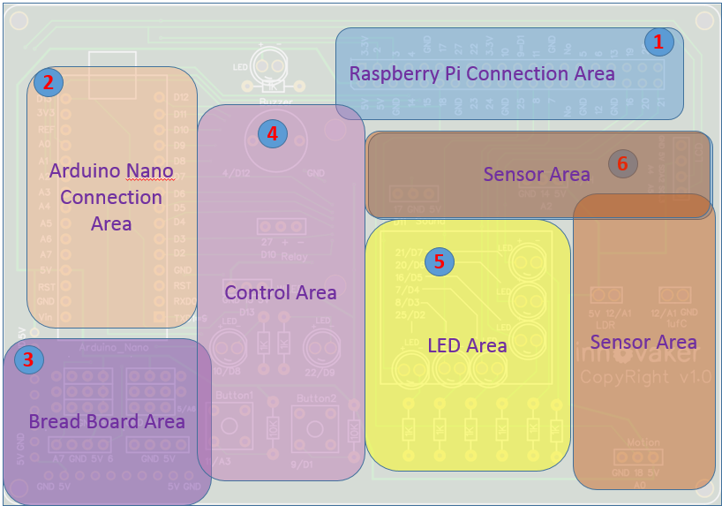
Innovaker Digital Circuits Kits layout
Innovaker Digital Circuits Kit, is a special designed STEM kits. It has built in Arduino Nano, and can connect to external Raspberry Pi.
5
Copyright @ 2018 Innovaker

Slide 6


Raspberry Pi
remote access
option 2
Use network cable to connect with router to get IP
Connect Pi with router with ethernet cable, start Pi, the IP will be displayed on LCD, then remote connect to Raspberry Pi through VNC viewer.
Option 1: use monitor / keyboard / mouse to connect to wifi (see previous slide)
Copyright @ 2018 Innovaker
Notes:
IP address
Get Pi IP address is one important step to use Pi with laptop or other computer.
If IP address for example as “192.168.0.15” is displayed on LCD, go to chapter VNC.
Here is workflow how to get wifi IP address:
If there is no IP address is displayed on LCD, there are three ways to get IP.
Use monitor / keyboard / mouse to connect to wifi
Use network cable to connect with router to get IP
Use smartphone hotspot to get IP
Following chapter will introduce above IP methods.
Innovaker Kits special feature (not come with Raspbian)
Option 2: Use network cable to connect with router to get IP
Connect Pi with router with ethernet cable, start Pi, the IP will be displayed on LCD, go to VNC chapter to setup Wifi or use directly.

Slide 7
Raspberry Pi
remote access
option 3
Use martphone hotspot to get IP
Set hotspot on smartphone,
the hotspot name “Pizhi”, password “innovaker”.
Start Pi with LCD, the LCD will display Pi IP of hotspot, go to VNC, then remote connect to Raspberry Pi through VNC viewer.
Option 1: use monitor / keyboard / mouse to connect to wifi (see previous slide)
Copyright @ 2018 Innovaker
Notes:
Innovaker Kits special feature (not come with Raspbian)
Option 3: Use martphone hotspot to get IP
Set hotspot on smartphone, the spot name “Pizhi”, password “innovaker”.
Start Pi with LCD, the LCD will display Pi IP of hotspot, go to VNC.

Slide 8
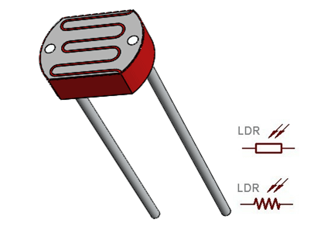
Electronic
component
--- Photoresistor
Photoresistor / LDR
A photoresistor is a light dependent resistor, meaning the value of its resistance changes according to the amount of light being shed on it. As the light intensity increase, the resistance of the photoresistor decreases. Uses of the photoresistor can be seen in night lights, street lamps, and outdoor clocks. In each case, we can see how the attributes of a photoresistor can be use to create light activated systems.
How does it work? In order to effectively use the photoresistor with the digital pins of the Raspberry Pi, we’re going to need the additional electrical component: the capacitor. Because the photoresistor is simply a resistor with changing values, we are building what’s known as a RC (resistor-capacitor) circuit. A special feature about RC circuits is that when we combine the two, it starts to take some time in order to charge up our capacitor. This amount of time is measurable and correlates with the brightness measured by our photoresistor. Thus, the value attained is essentially a measure of the brightness.
Copyright @ 2018 Innovaker
Notes:
Teacher notes:
What is a photoresistor?
A photoresistor is a light dependent resistor, meaning the value of its resistance changes according to the amount of light being shed on it. As the light intensity increase, the resistance of the photoresistor decreases. Uses of the photoresistor can be seen in night lights, street lamps, and outdoor clocks. In each case, we can see how the attributes of a photoresistor can be use to create light activated systems.
How does it work?
In order to effectively use the photoresistor with the digital pins of the Raspberry Pi, we’re going to need the additional electrical component: the capacitor. Because the photoresistor is simply a resistor with changing values, we are building what’s known as a RC (resistor-capacitor) circuit. A special feature about RC circuits is that when we combine the two, it starts to take some time in order to charge up our capacitor. This amount of time is measurable and correlates with the brightness measured by our photoresistor. Thus, the value attained is essentially a measure of the brightness.

Slide 9

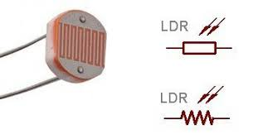
Electronic
component
--- Photoresistor
Copyright @ 2018 Innovaker
Notes:
Teacher notes:
What is a photoresistor?
A photoresistor is a light dependent resistor, meaning the value of its resistance changes according to the amount of light being shed on it. As the light intensity increase, the resistance of the photoresistor decreases. Uses of the photoresistor can be seen in night lights, street lamps, and outdoor clocks. In each case, we can see how the attributes of a photoresistor can be use to create light activated systems.
How does it work?
In order to effectively use the photoresistor with the digital pins of the Raspberry Pi, we’re going to need the additional electrical component: the capacitor. Because the photoresistor is simply a resistor with changing values, we are building what’s known as a RC (resistor-capacitor) circuit. A special feature about RC circuits is that when we combine the two, it starts to take some time in order to charge up our capacitor. This amount of time is measurable and correlates with the brightness measured by our photoresistor. Thus, the value attained is essentially a measure of the brightness.

Slide 10
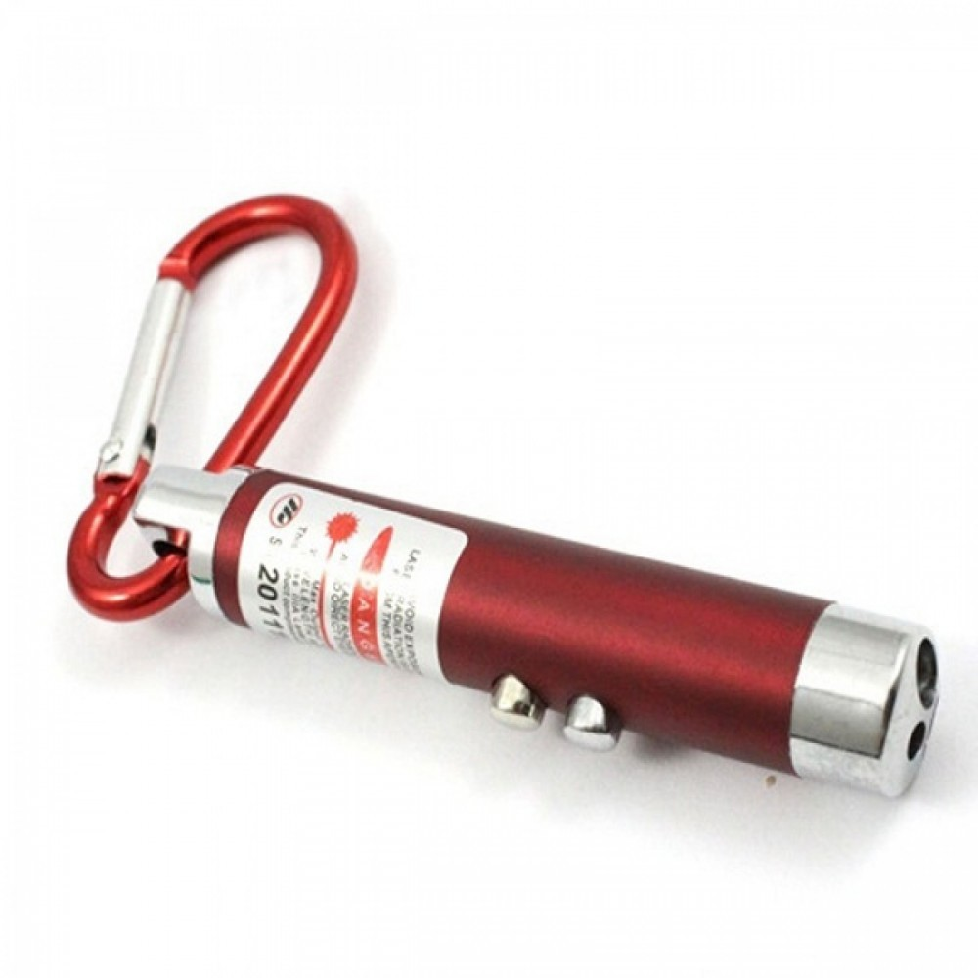
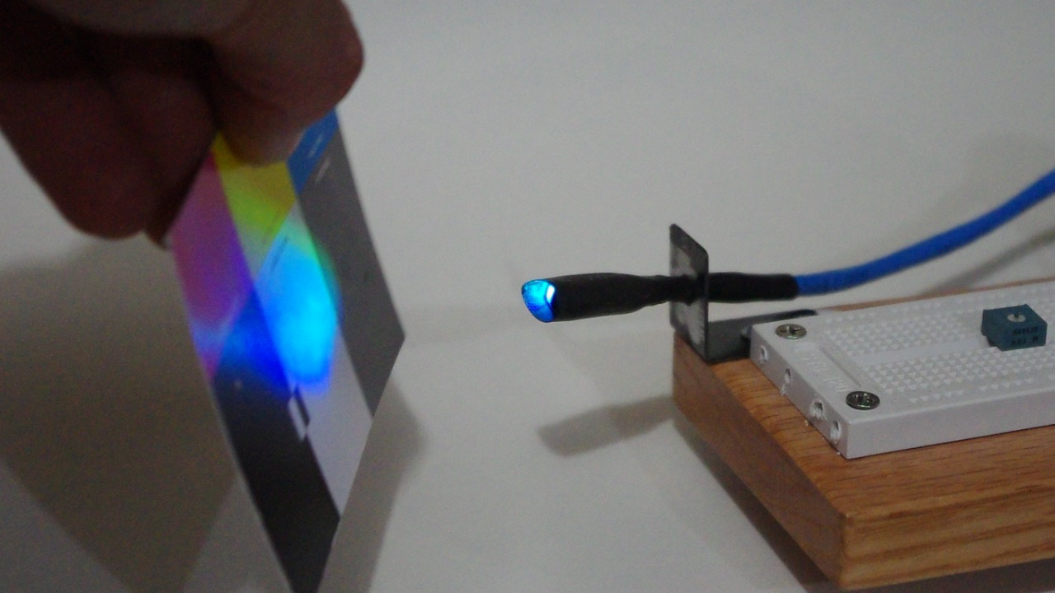
Electronic
component
--- Laser pointer
Laser pointer
A laser pointer or laser pen is a small handheld device with a power source (usually a battery) and a laser diode emitting a very narrow coherent low-powered laser beam of visible light, intended to be used to highlight something of interest by illuminating it with a small bright spot of colored light. Power is restricted in most jurisdictions not to exceed 5 mW.
How does laser work? Once a laser has power and something to pass through, it becomes a concentrated beam. This beam can then be emitted outward in a single line of bright light. The word "laser" is an acronym that stands for "light amplification by the stimulated emission of radiation."
Copyright @ 2018 Innovaker
Notes:
Teacher notes:
There are two types of laser pointers. The ruby laser projects a red beam of light, resulting in a red dot. Inside the laser pointer is a ruby rod. On one end is a mirror and the other is a partially see-through mirror. A flash tube acts as a light source and is at one end of the rod. When a user presses a button on the side of the ruby laser pointer, the flash tube agitates atoms inside the rod. The atoms bounce off of the solid mirror and exit the laser pointer through the see-through one. This is what projects the beam of light onto a surface of the user's choosing.
Green laser pointers operate in the exact same way as ruby laser pointers. The sole exception is that instead of a ruby rod that emits a red-colored beam of light, there is a green rod that emits a green beam of light. The green rod is able to produce a more focused and powerful beam of light, which also makes it more dangerous. Pointing a green laser pointer directly into someone's eyes can quickly lead to blindness.

Slide 11

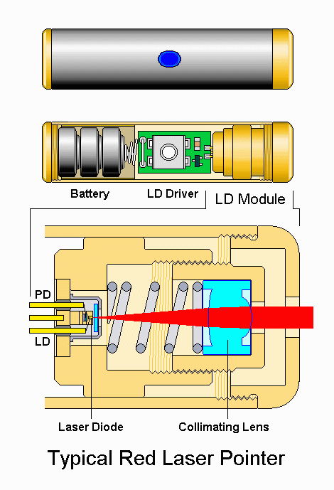
Electronic
component
--- Laser pointer
Copyright @ 2018 Innovaker
Notes:
Teacher notes:
There are two types of laser pointers. The ruby laser projects a red beam of light, resulting in a red dot. Inside the laser pointer is a ruby rod. On one end is a mirror and the other is a partially see-through mirror. A flash tube acts as a light source and is at one end of the rod. When a user presses a button on the side of the ruby laser pointer, the flash tube agitates atoms inside the rod. The atoms bounce off of the solid mirror and exit the laser pointer through the see-through one. This is what projects the beam of light onto a surface of the user's choosing.
Green laser pointers operate in the exact same way as ruby laser pointers. The sole exception is that instead of a ruby rod that emits a red-colored beam of light, there is a green rod that emits a green beam of light. The green rod is able to produce a more focused and powerful beam of light, which also makes it more dangerous. Pointing a green laser pointer directly into someone's eyes can quickly lead to blindness.

Slide 12

Electronic
component
--- Laser pointer
safety tips
Copyright @ 2018 Innovaker
Notes:
Teacher notes:
Laser tag game, wear the goggle
There are two types of laser pointers. The ruby laser projects a red beam of light, resulting in a red dot. Inside the laser pointer is a ruby rod. On one end is a mirror and the other is a partially see-through mirror. A flash tube acts as a light source and is at one end of the rod. When a user presses a button on the side of the ruby laser pointer, the flash tube agitates atoms inside the rod. The atoms bounce off of the solid mirror and exit the laser pointer through the see-through one. This is what projects the beam of light onto a surface of the user's choosing.
Green laser pointers operate in the exact same way as ruby laser pointers. The sole exception is that instead of a ruby rod that emits a red-colored beam of light, there is a green rod that emits a green beam of light. The green rod is able to produce a more focused and powerful beam of light, which also makes it more dangerous. Pointing a green laser pointer directly into someone's eyes can quickly lead to blindness.

Slide 13
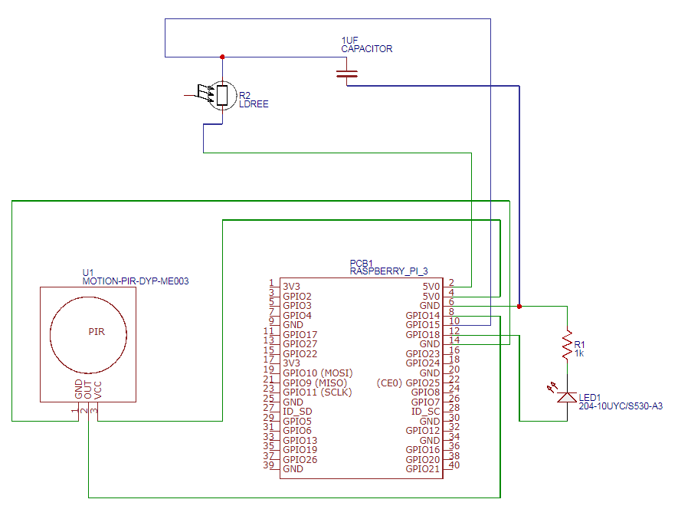
photoresistor
diagram
Copyright @ 2018 Innovaker
Notes:
Teacher notes:

Slide 14
Demo Project
photoresistor I
import RPi.GPIO as GPIO import time
LED_PIN = 10 LDR_PIN = 12
def setup(): GPIO.setmode(GPIO.BCM) GPIO.setup(LED_PIN, GPIO.OUT)
Copyright @ 2018 Innovaker
Notes:
Teacher notes:
Writing the Code
The following program uses values from our LDR to obtain a brightness value and light up an LED based on that. Take special note of the rc_time method, which we use to attain a brightness value.

Slide 15
Demo Project
photoresistor I
def rc_time(pin): count = 0 GPIO.setup(pin, GPIO.OUT) GPIO.output(pin, GPIO.LOW) time.sleep(0.1) GPIO.setup(pin, GPIO.IN) while(GPIO.input(pin) == GPIO.LOW): count += 1 return count | The rc_time method is used to attain a value for the brightness. The count variable is used as a way to keep track of the time it takes for our capacitor to be charged First, we setup our GPIO pin as an output pin and allow it to output a low value. Afterwards, we redefine the pin to be a input pin Within our while loop, we constantly read whether we are still getting a GPIO.LOW value. Because charge is slowly being built up in the capacitor, the input from this pin will eventually become GPIO.HIGH, causing our while loop to terminate. The amount of time we must wait for this to happen is dependent on the value of the LDR, and thus indicative of the brightness
Copyright @ 2018 Innovaker
Notes:
Teacher notes:

Slide 16
Demo Project
photoresistor I
def main(): while True: brightness = rc_time(LDR_PIN) print(brightness) if brightness > 600: GPIO.output(LED_PIN, GPIO.HIGH) time.sleep(1) else: GPIO.output(LED_PIN, GPIO.LOW) time.sleep(1) | Using the rc_time method, we obtain real time values for the current brightness. We can then set a threshold which upon being passed causes our LED to light up
if __name__ == '__main__': try: setup() main() finally: GPIO.cleanup()
Copyright @ 2018 Innovaker
Notes:
Teacher notes:

Slide 17
Demo Project
additional demo
Copyright @ 2018 Innovaker
Notes:
Teacher notes:

Slide 18
Demo Project
photoresistor II
import RPi.GPIO as GPIO import time
LED_PIN = 10 LDR_PIN = 12 MOTION_PIN = 18
def setup(): GPIO.setmode(GPIO.BCM) GPIO.setup(LED_PIN, GPIO.OUT) GPIO.setup(MOTION_PIN, GPIO.IN, pull_up_down=GPIO.PUD_DOWN) | Similarly to our callback implementation of the button, we use the GPIO.add_event_detect method to add a callback function that is implemented when a motion is detected The bouncetime parameter offers some buffer time before the motion detection can be retriggered
Copyright @ 2018 Innovaker
Notes:
Teacher notes:
One more additional project to demonstrate photoresistor

Slide 19
Demo Project
photoresistor II
def rc_time(pin): count = 0 GPIO.setup(pin, GPIO.OUT) GPIO.output(pin, GPIO.LOW) time.sleep(0.1) GPIO.setup(pin, GPIO.IN) while(GPIO.input(pin) == GPIO.LOW): count += 1 return count | The rc_time method is used to attain a value for the brightness. The count variable is used as a way to keep track of the time it takes for our capacitor to be charged First, we setup our GPIO pin as an output pin and allow it to output a low value. Afterwards, we redefine the pin to be a input pin Within our while loop, we constantly read whether we are still getting a GPIO.LOW value. Because charge is slowly being built up in the capacitor, the input from this pin will eventually become GPIO.HIGH, causing our while loop to terminate. The amount of time we must wait for this to happen is dependent on the value of the LDR, and thus indicative of the brightness
Copyright @ 2018 Innovaker
Notes:
Teacher notes:

Slide 20
Demo Project
photoresistor II
def main(): while True: brightness = rc_time(LDR_PIN) print(brightness) motion = GPIO.input(MOTION_PIN) print(motion) if motion and brightness > 400: GPIO.output(LED_PIN, GPIO.HIGH) time.sleep(1) else: GPIO.output(LED_PIN, GPIO.LOW) time.sleep(1) | Using the rc_time method, we obtain real time values for the current brightness. We can then set a threshold which upon being passed causes our LED to light up
if __name__ == '__main__': try: setup() main() finally: GPIO.cleanup()
Copyright @ 2018 Innovaker
Notes:
Teacher notes:

Slide 21
summary
What we learned so far?
. Basic concept of electric circuit
. What is photoresistor?
. What is laser?
. Demo project --- photoresistor project
Copyright @ 2018 Innovaker
Notes:
Teacher notes:

Slide 22

Latest Technology
---
What is 5G?
Copyright @ 2018 Innovaker
Notes:
Teacher notes:
5G is the coming fifth-generation wireless broadband technology based on the IEEE 802.11ac standard. ...5G will provide better speeds and coverage than the current 4G. 5G operates with a 5Ghz signal and is set to offer speeds of up to 1 Gb/s for tens of connections or tens of Mb/s for tens of thousands of connections.

Slide 23

Congratulations On Finishing
Copyright @ 2018 Innovaker

